Slide 1
Technology Presentation:
Area under the curve
Lindsay Byer

Slide 2
01
02
Review
Evaluation Theorem
03
04
Example 1
Example 2
TODAY’S AGENDA:

Slide 3
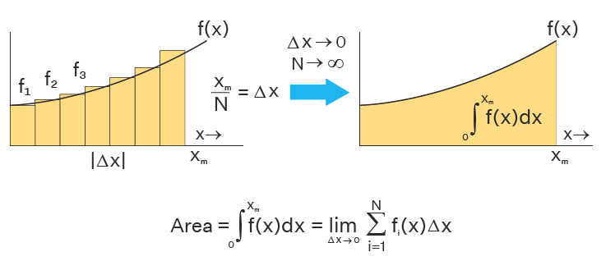
Review
Notes:
We have been on a quest to find area between the graph of f(x) and the x-axis over a given interval. We began by making estimations using rectangles and sample points and adding them all up. Then we learned the definite integral can be used to find the exact area. Today, we will take it a step further with the evaluation theorem.

Slide 4
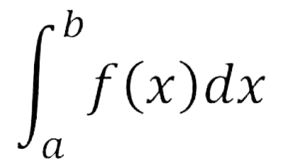
Evaluation Theorem
= F(b) - F(a)
Notes:
The evaluation theorem allows us to exactly find the area without any estimations using the antiderivative of f(x) denoted as F(x). Then we will plug in our endpoints and subtract.

Slide 5
Desmos
Notes:
When you get to desmos, please click on graphing calculator. Once you do that you will be brought to an empty graph with a column on the left side

Slide 6
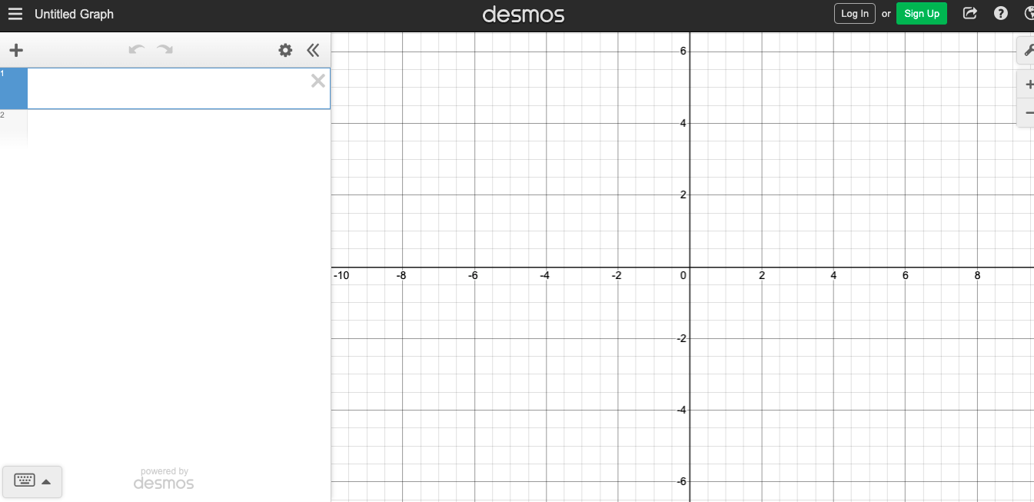
Notes:
Now we are ready to try an example together.

Slide 7
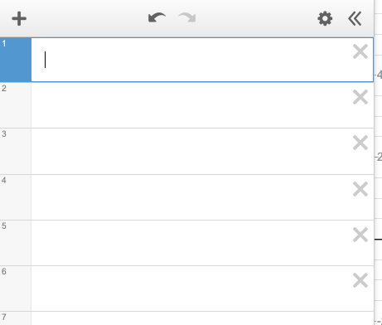
Example 1:
Determine the area represented by the definite integral.
Steps:
f(x) into desmos
f(x)=
x^4/5
x = a
x bounds:
x = 0 , x = 1
x = b
y bound:
y = 0
y bound
Shade in the region : Inequality
inequality:
0 <= y <= f(x) {0 <= x <= 1}
Check answer on desmos
**You solve it first!

Slide 8
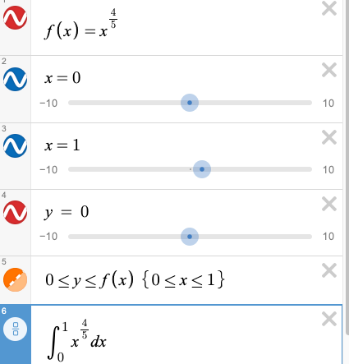
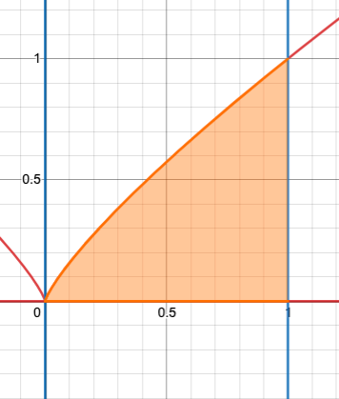
Example 1: cont’d

Slide 9
Example 2:
Determine the area represented by the definite integral.
Steps:
f(x) into desmos
f(x)=
(x)^1/3
x = a
x bounds:
x = 1 , x = 8
x = b
y bound
y bound:
y = 0
Shade in the region : Inequality
inequality:
0 <= y <= f(x) {1 <= x <= 8}
Check answer on desmos
**You solve it first!

Slide 10
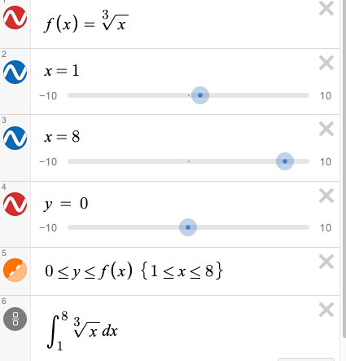
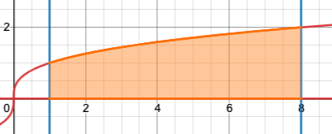
Example 2: cont’d

Slide 11
Example 3:
Determine the area represented by the definite integral.
Steps:
f(x)=
(2x - e^x)
f(x) into desmos
x = a
x bounds:
x = -1 , x = 0
x = b
y bound:
y = 0
y bound
inequality:
f(x) <= y <= 0 {-1 <= x <= 0}
Shade in the region : Inequality
Check answer on desmos
**You solve it first!

Slide 12
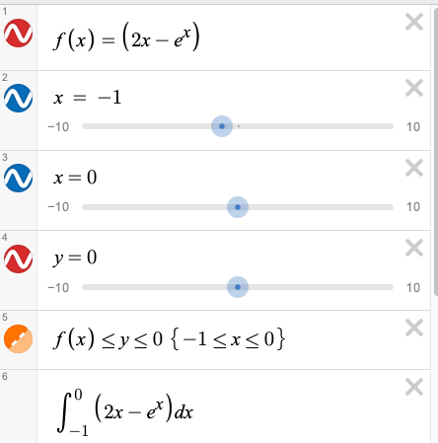
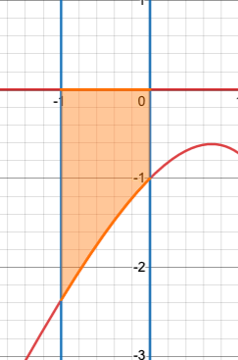
Example 3 cont’d:
= -1.63212055883

